Slide 1
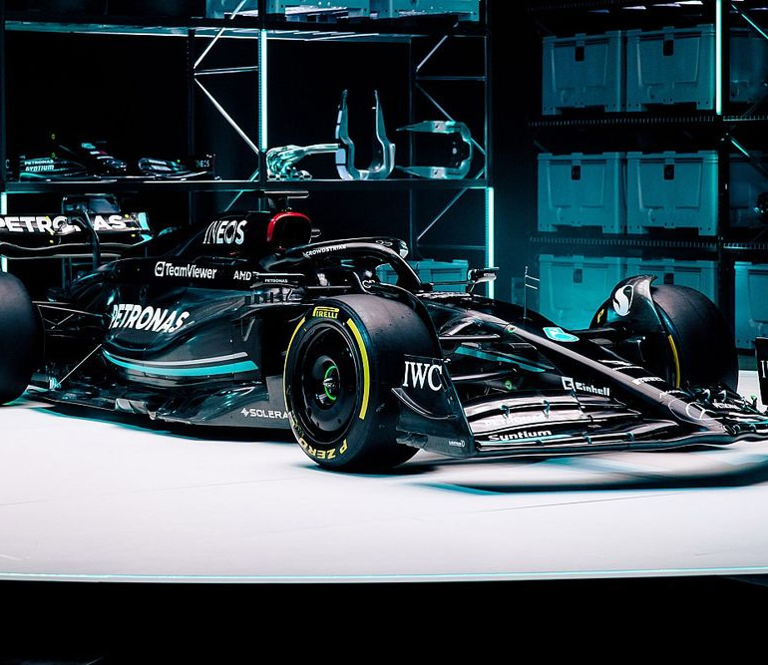
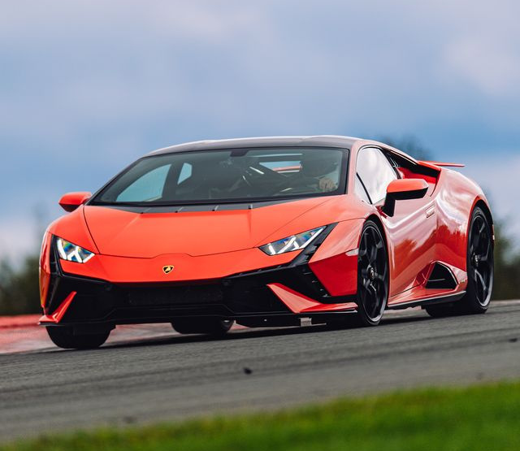
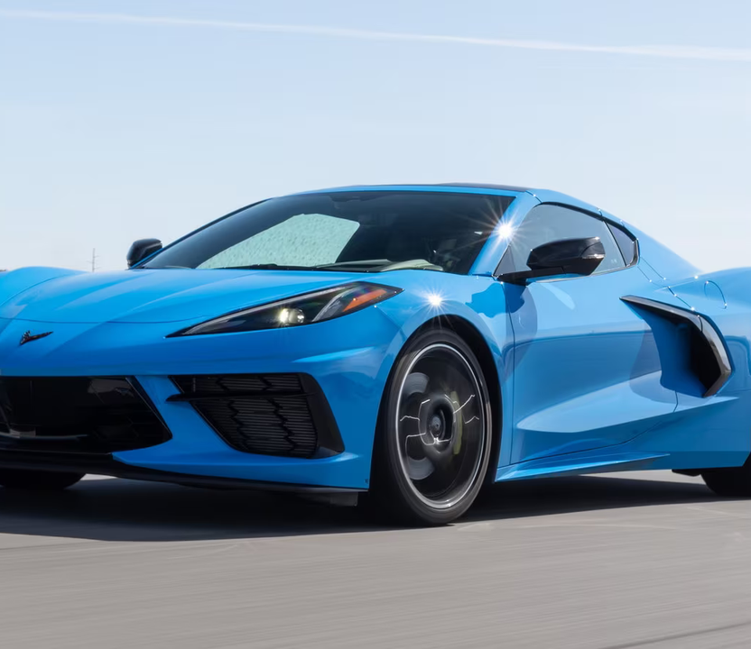

DATA ANALYSIS
Car Price Prediction

Slide 2
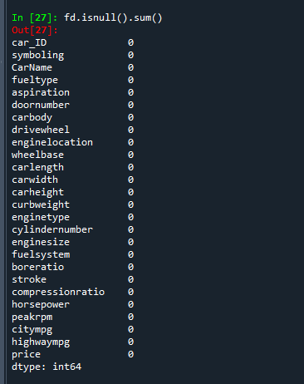
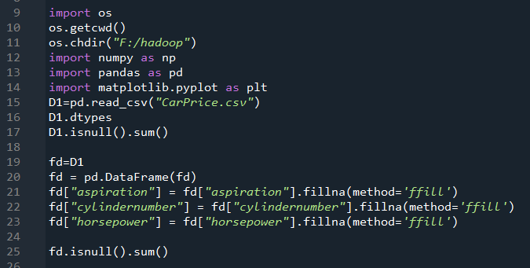
PREPROCESSING

Slide 3
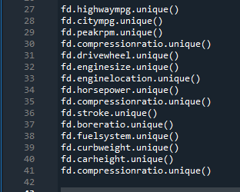
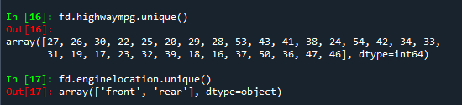

Slide 4
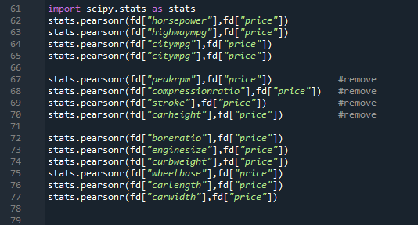
EDA - CONTINUOUS VARIABLE

Slide 5
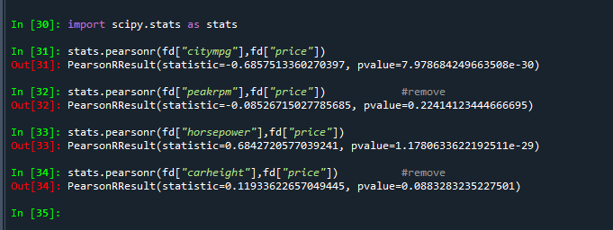
Output

Slide 6
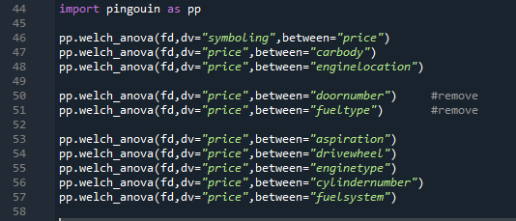
EDA - ONE CATEGORICAL AND ONE CONTINEOUS

Slide 7
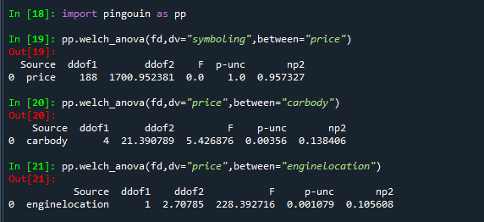
Output

Slide 8
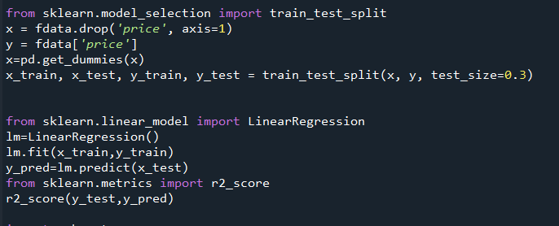
MODELING
Linear Regression

Slide 9
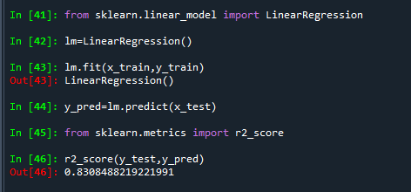
Output
Linear Regression gave 83% accuracy.

Slide 10

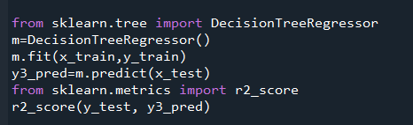
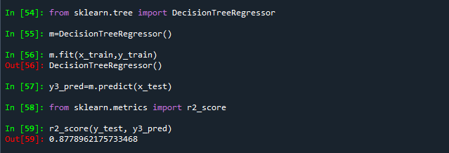
Decision Tree Regressor
<-CODE
Output ->
The decision tree regressor model gave us 87.78%
accuracy.

Slide 11
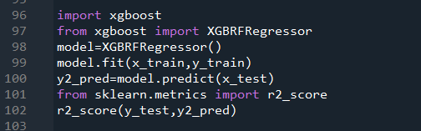
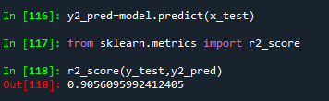

XGBRFRegressor
<-CODE
Output ->
XGBRFRegressor gave a better fit
with 90.56% accuracy

Slide 12
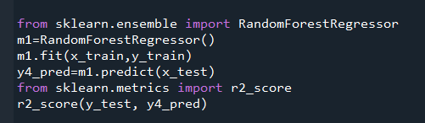
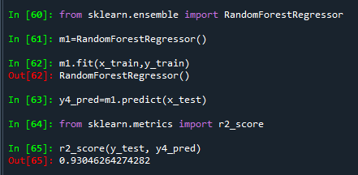
Random forest Regressor
<-CODE
Output ->
Random Forest regressor model gives the best fit with 93.04% accuracy.

Slide 13
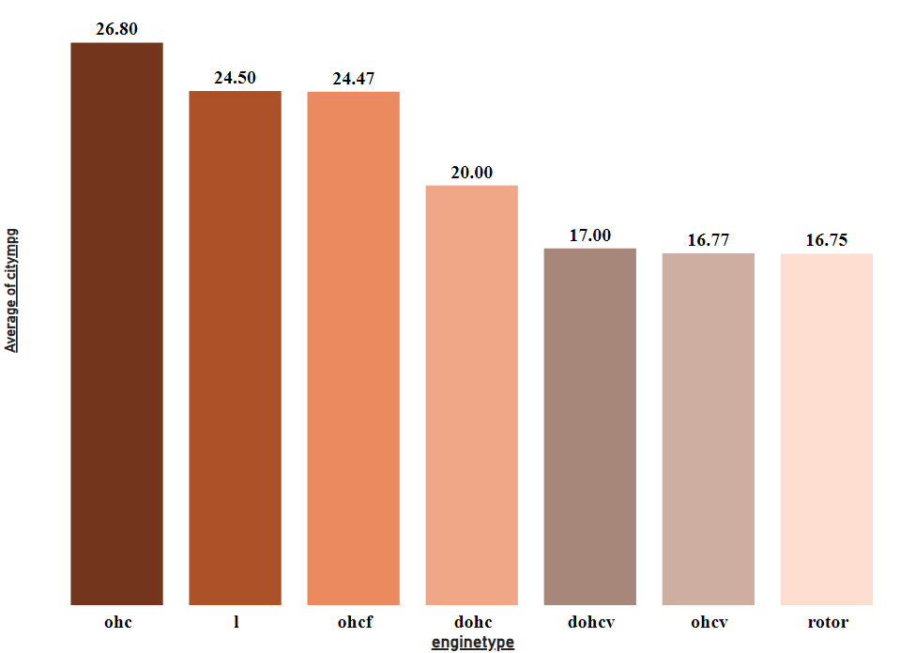
CONCLUSION
OHC engine type gives the most efficient outcome when it comes to miles per gallon, i.e., the mileage of the car.
BUT...

Slide 14
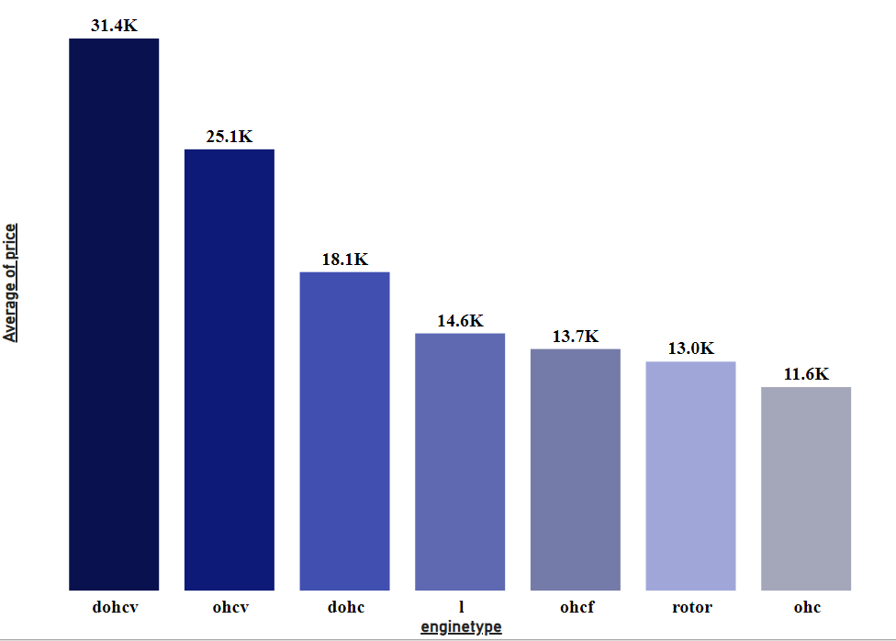
OHC is the most affordable engine out there, even though it's the most efficient.
When considering expenses, engines with higher power levels tend to be more costly than their less powerful counterparts.

Slide 15
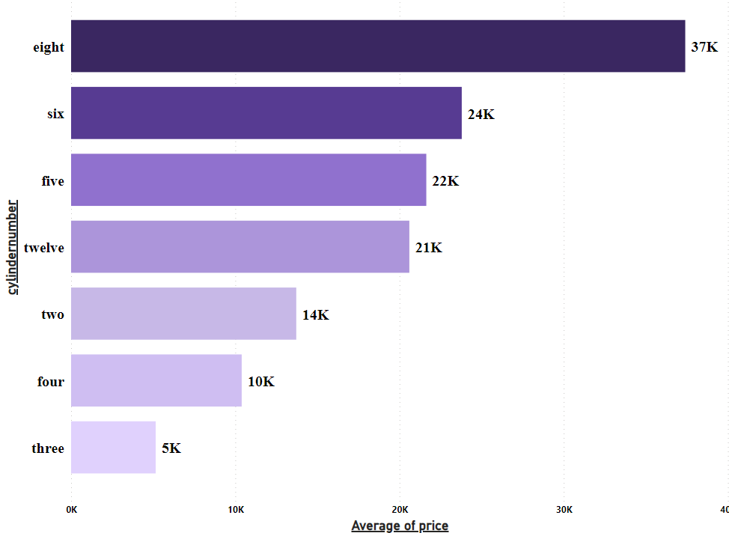
V8 engines are considered the most expensive engines out there due to their highly complex structure and high performance.
It was used in F1 cars from the year 2006 to 2013.

